Slide 1
Inclusion Exclusion

Slide 2
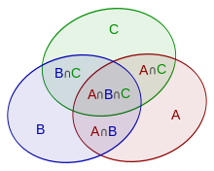

Slide 3
Prime problem

Slide 4
Light Oj 1144 - Ray Gun
You are in an m x n grid. You are standing in position (0, 0) and in each of the other lattice points (points with integer co-ordinates) an enemy is waiting. Now you have a ray gun that can fire up to infinity and no obstacle can stop it. Your target is to kill all the enemies. You have to find the minimum number of times you have to fire to kill all of them. For a 4 x 4 grid you have to fire 13 times. See the picture below:
Input
Input starts with an integer T (≤ 100), denoting the number of test cases.
Each case contains two integers m, n (0 ≤ m, n ≤ 10⁹) and at least one of them will be less than or equal to 10⁶.

Slide 5
1161 - Extreme GCD
All of you know that GCD means the greatest common divisor. So, you must have thought that this problem requires finding some sort of GCD. Don't worry, you are absolutely right!
Given N positive integers, not necessarily distinct, how many ways you can take 4 integers from the N numbers such that their GCD is 1.
Input
Input starts with an integer T (≤ 20), denoting the number of test cases.
Each case starts with an integer N (4 ≤ N ≤ 10000). The next line contains N integers separated by spaces. The integers will be positive and not greater than 10000.

